Slide 1
Interplay between Optimization and Generalization in DNNs
S. Sathiya Keerthi
Microsoft (Office-FAST Data Science Team)
keerthi@microsoft.com
Criteo Workshop on ML in the Real World
November 8, 2017, Paris, France
DNN = Deep Neural Network
References are hyperlinked at appropriate places.
Notes in individual slides contain additional comments.
Notes:
DNN Generalization has been a recent hot topic – my aim is to give an overview of one aspect of it – its interplay with optimization.
Current state: there are several loose ends.
Typical of the DNN area – many (possibly conflicting) empirical works have shown up in this early stage. We need to wait for a year or more to see a clear picture.
Optimization refers to Training. The talk will be mostly about the role of the optimization method on the final generalization.
More specifically, in highly non-linear and non-convex over-parametrized systems (this is the case in most powerful DNNs employed recently in applications) can some optimization methods have the potential to consistently lead to solutions with great generalization?
The natural follow up question is: how can optimization methods be modified so that generalization is better and also easier to attain. So there is an interplay.

Slide 2
DNN Optimization (Training)

Slide 3
Optimization Methods
Let be the Error function to minimize
Weight update:
(Batch) Gradient descent (GD):
We can include gradient-based optimization methods in this class of methods
(Mini-batch) SGD*: - B is a mini-batch
There exist many variants such as momentum, Adam etc.
GD can be viewed as SGD with a large batch
Rest of the talk: SGD will simply refer to the plain mini-batch SGD
Smaller batch sizes mean more noisy (jumpy) updates
*SGD = Stochastic GD
Notes:
Without going to a detailed list of possible methods let’s just narrow down our analysis to a couple of optimization methods.
One is deterministic and the other is stochastic.
By SGD we will refer to mini-batch SGD.
SGD with a large batch can be taken as a proxy for GD. We will compare only these two in this talk. However, let’s be aware that each specific method in the whole gamut of training methods will have a different signature of movement in weights space and the associated final generalization properties.
For example there is a paper which says Adam like methods do not do as well as sgd.

Slide 4
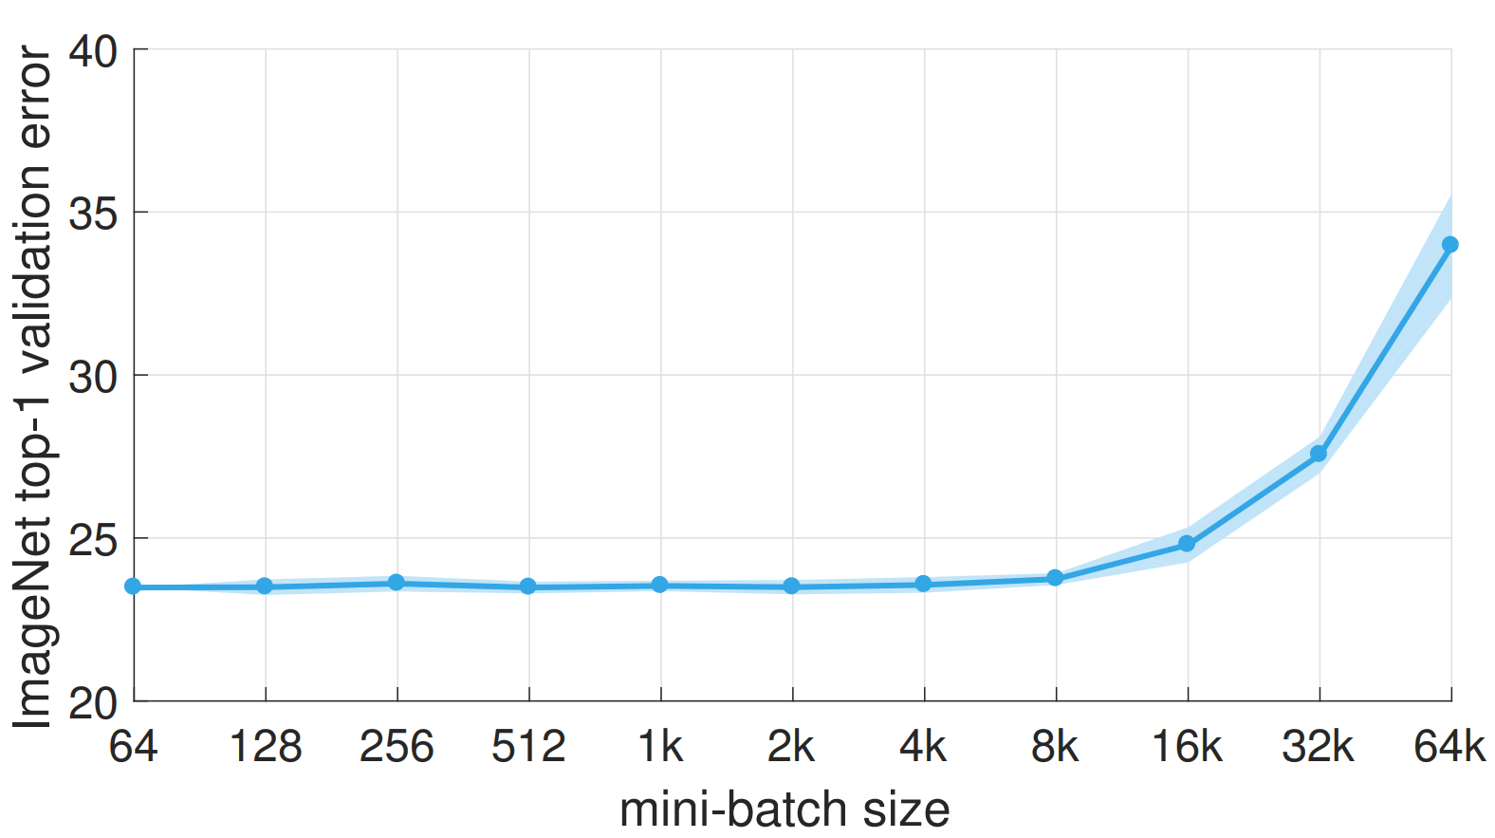
Large batch sizes have an adverse effect on generalization
SGD on DNNs -
Effect of batch size
DNN practitioners have been aware of this for more than 5 years.
But no clear arguments for why this is so.
Goyal et al, arXiv:1706.02677
Notes:
Note the significant increase in gen error for large batch sizes.
Also see Keskar et al, ICLR 2017 - http://www.iclr.cc/lib/exe/fetch.php?media=iclr2017:nocedal_iclr2017.pdf
I will discuss this again, a bit later.

Slide 5
DNNs & Over-Parametrization [Ref]

Slide 6
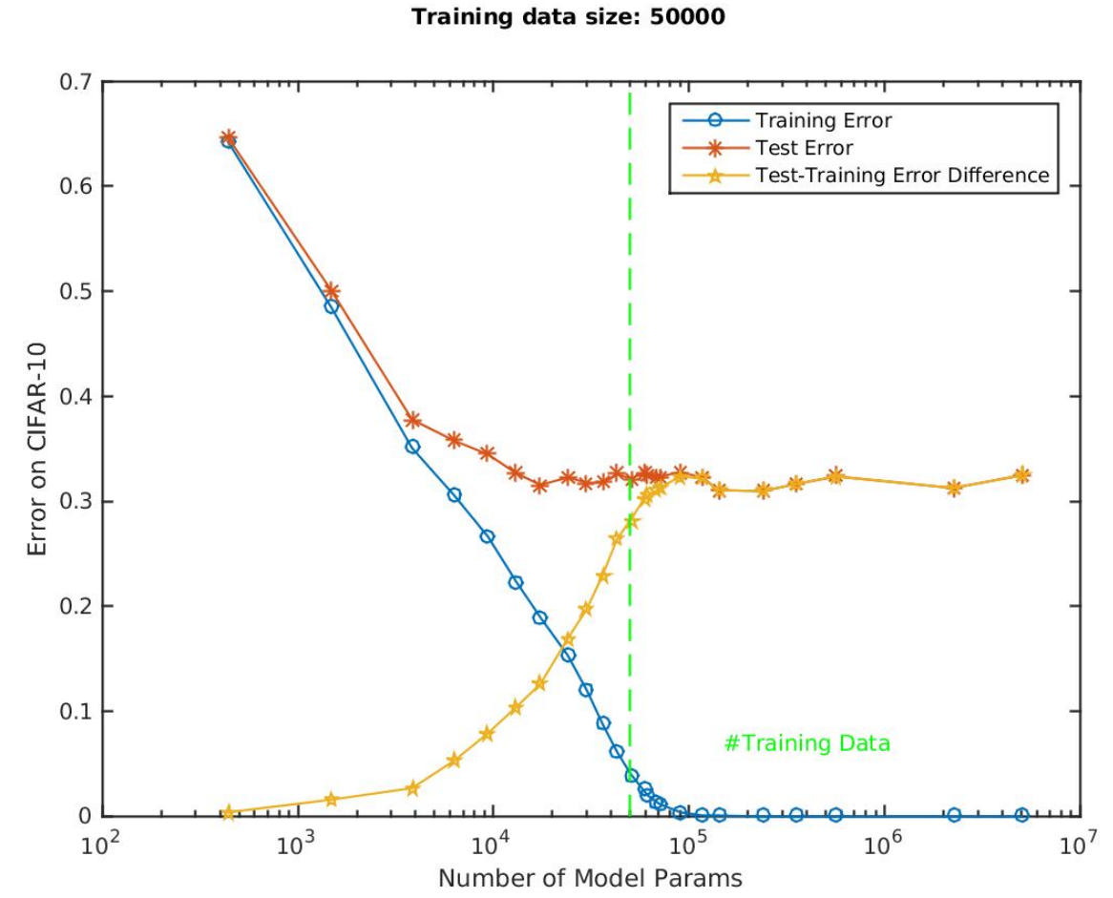
DNNs: Over-parametrization yields great generalization even without any explicit regularization
The interesting part – Great generalization!
Note the zero training error in the over-parametrized part
DNN forms patterns, thus generalizing well
It also memorizes noisy examples, but in a harmless way
All these need more understanding
Zhang et al, Theory of deep learning III, September 2017
Notes:
“great generalization” does not mean “optimal generalization” – it just means that it is quite close to what can be optimally achieved.
Even when data is completely random, these over-parametrized DNNs can memorize them, but they will lead to poor generalization as expected.

Slide 7
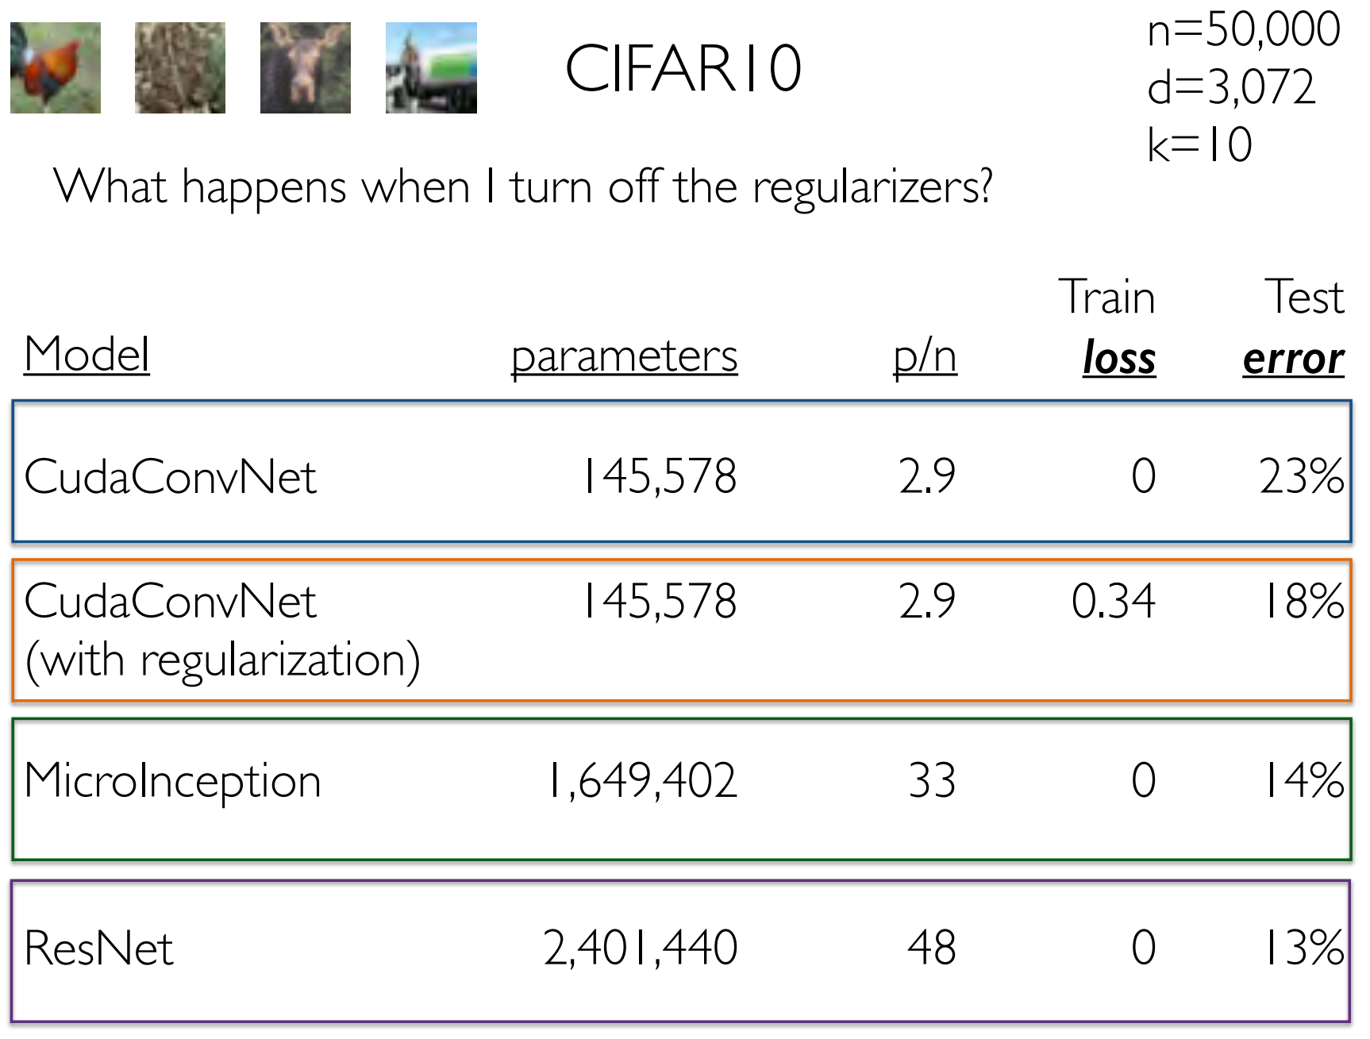
More examples of great generalization without any regularization
n = number of examples
p = number of parameters
d = number of inputs
k = number of layers
Note that networks with larger p/n have better generalization
Ben Recht Talk slides, ICLR 2017

Slide 8
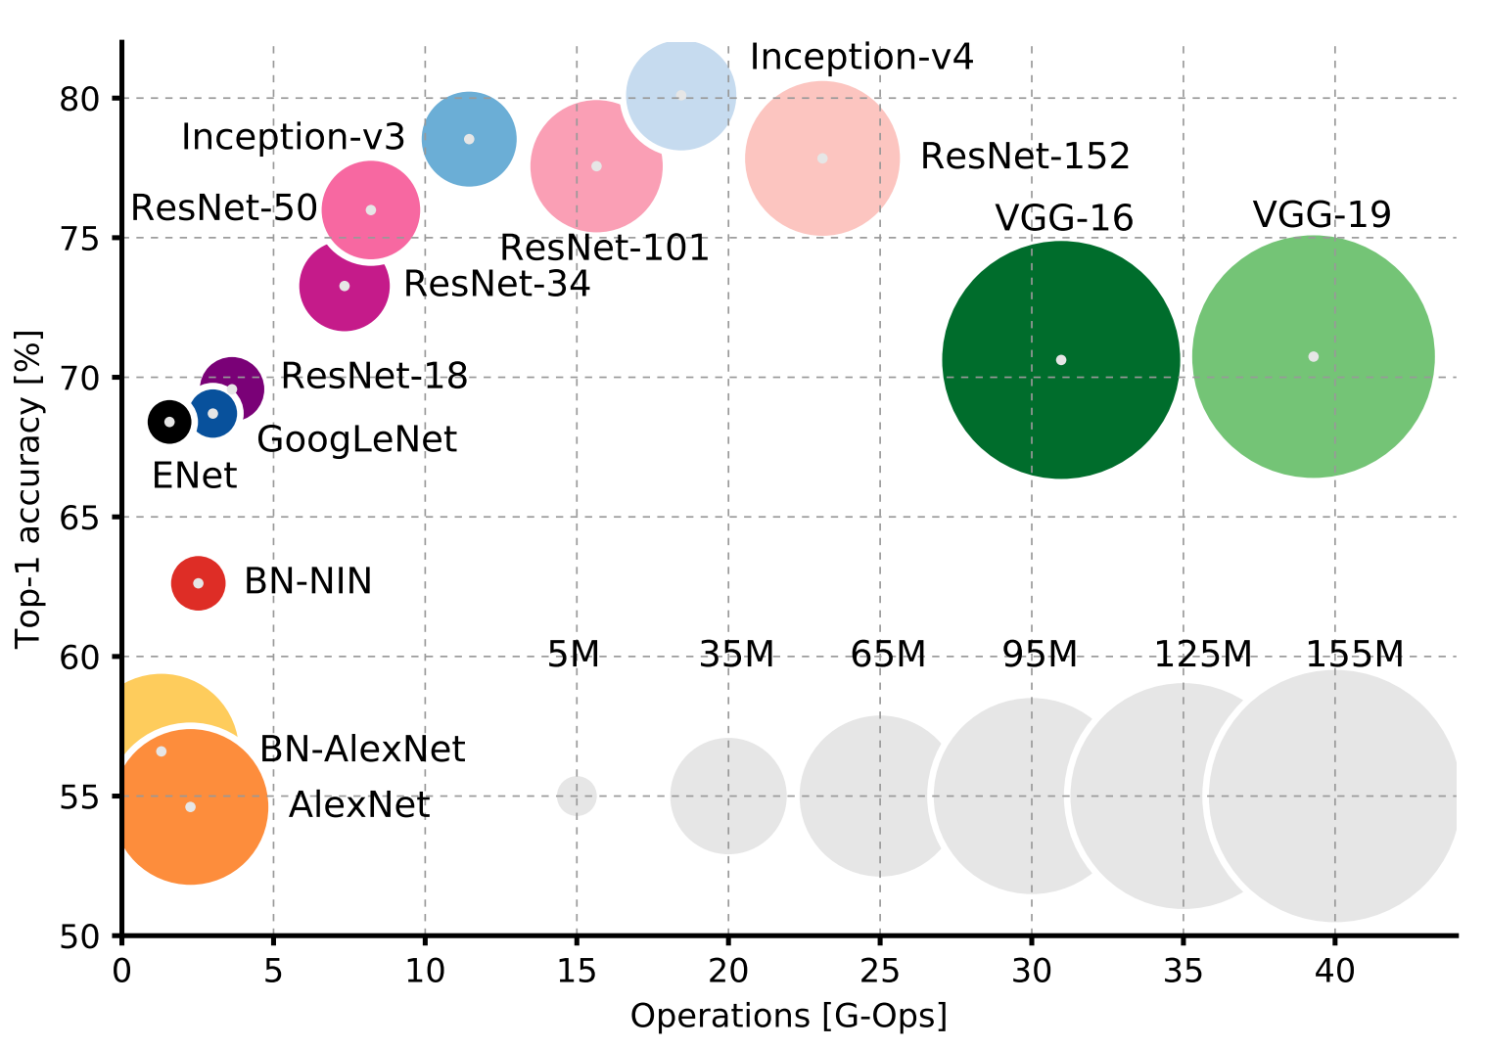
History of powerful DNN solvers on ImageNet (15 million examples) [Ref]

Slide 9
In the rest of the talk let’s focus on Over-parametrized systems

Slide 10
Kernel Methods [Ref]
Notes:
It is good to start with something simple such as kernel methods and analyze the over-parametrized case.
This part is from Ben Recht ICLR 2017 Talk slides with added comments from me – that, minmum norm property is nothing special to sgd.

Slide 11
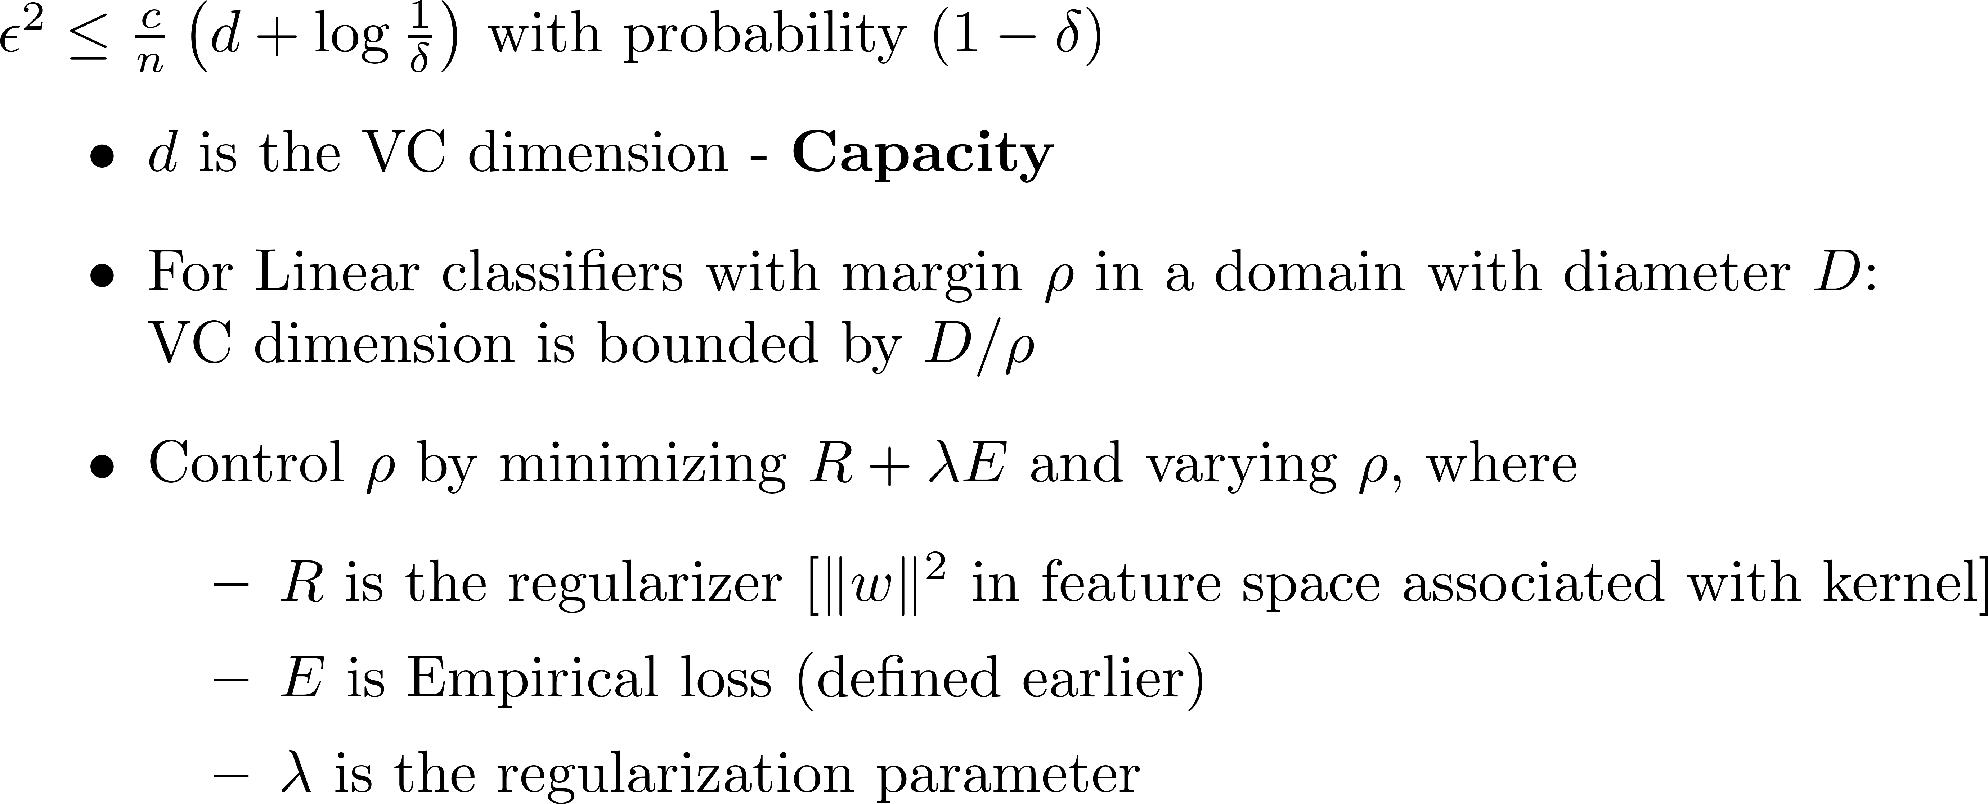
Standard approach based on regularization
Bound on Generalization (gap) error,
Clean approach to get good generalization by controlling the capacity
Notes:
Because of its clean linear set up, this approach using margin-based capacity control works magically for kernel methods. In DNNs, the processing goes through many complex layers of nonlinear operation and hence, doing a similar control of capacity is non-trivial. This is a current hot area of research – some of those works are strongly motivated by the “flatness” criteria that we will discuss in this talk. In a crude sense, this “flatness” plays a role similar to “margin”.
The generalization error bound is theoretical. In practice, error on a validation set is used to tune lambda.

Slide 12
In kernel methods, Regularization is sufficient for getting good generalization performance. But is it necessary?
Consider an experiment ..

Slide 13
Over-parametrization: SGD + No regularization
Let us consider squared loss:
SGD update:
If we start from then the weight vector at any stage can be written as
SGD can be shown to converge to a minimizer, under suitable control of
Assume X is full rank
Over-parametrization means:
This means:
If we work in kernel feature space and use the kernel trick:
Same as a kernel method moving to zero regularization:
Notes:
Note that, with kernels, when we say SGD we are talking about SGD in the feature space – so, the implementation has to be done via updating of alphas.
Zero regularization is same as hard margin, for classification.

Slide 14
Kernel method with zero regularization gives great performance!
Example: On MNIST, with RBF kernel, it gets a test error of 1.2% which is smaller than that of SVM (1.4%)
Notes:
Repeating what we said earlier: We are not saying here that zero regularization gives the optimal performance.

Slide 15
Reason: SGD goes to Minimum Norm Solution
The solution is nothing but the minimum norm solution:
Minimum norm solution also has nice robustness properties –
Insensitivity of the output to input changes
Hence it also has good generalization
That’s a WOW property of SGD – but how did it get it? Let’s try to understand this.

Slide 16
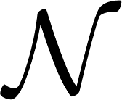
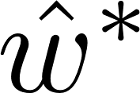
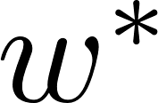
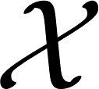
Notes:
Look at the red line of ALL possible minima of E. It is a manifold of size (p-n) where p is the number of parameters and n is the number of examples. The corresponding entity in DNNs is a nonlinear manifold of the same dimension.

Slide 17
There is nothing special about SGD
We will get minimum norm solution whenever we use any gradient based method and start from
With DNNs, we will see that SGD is indeed special.
But, that comes about not because of the property we are discussing here.
A related note:
Linear case: Hessian* of the empirical loss, E, is constant for quadratic loss.
It is mildly varying for other losses.
In DNNs, the Hessian is highly varying as a function of w. This is an important factor for consideration.
*Hessian is the matrix of second order partial derivatives of E with respect to the weights
Notes:
In general, the structure (Loss as a function of weights) is a lot more complex in DNNs (compared to linear solutions), and that too, in over-parametrized DNNs. Bad local minima (minima with high loss values), Good local minima (minima with small loss values); also, just because the loss value if very small (say, even a global min) it doesn’t mean it is a good place to be for great generalization; what seems more important is to be at places where loss is decently small and also has a flat behavior.

Slide 18
Over-Parametrized DNNs - Some Basic Insights

Slide 19
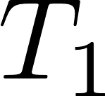
Understanding via Hessian Properties
Let’s take squared loss for easy analysis:
Gradient:
Hessian:
Note:
When the
Over-parametrized case: the rank of is limited by the number of examples, n
Local minima: have large values - we can expect Hessian to be sharp
Global minima: have small values – Hessian is heavily rank deficient
In the perfect zero error case a global minimum of over-parametrized DNNs is degenerate – it is a nonlinear manifold of large dimension
Hessian is dominated by and, it varies a lot across that manifold – this is a property that makes DNNs very different from linear systems
There are numerous such global minimums
Notes:
Local minima: Because of the H_i term, Hessian is sharp in ALL directions.
Global minima perfect zero error case: e_i=0 for all I defines a nonlinear manifold of dimension (p-n).
There can be many global minima – the permutation invariance is one cause of this – but that is immaterial.

Slide 20
Ease of reaching a global Minimum
In the lightly over-parametrized (or under-parametrized) case, the error function is lot more sharper
Chances of getting caught in a poor local minimum is higher, especially for a low-noise methods such as GD and SGD with large batch sizes
The time taken to go to a minimum is generally large
Over-parametrized systems do not suffer from such issues
Getting to a global minimum is easy*
Training time is also much shorter
*With sigmoid/tanh activations there can be some slow down due to the flat ends, but that can be overcome using good heuristics.

Slide 21
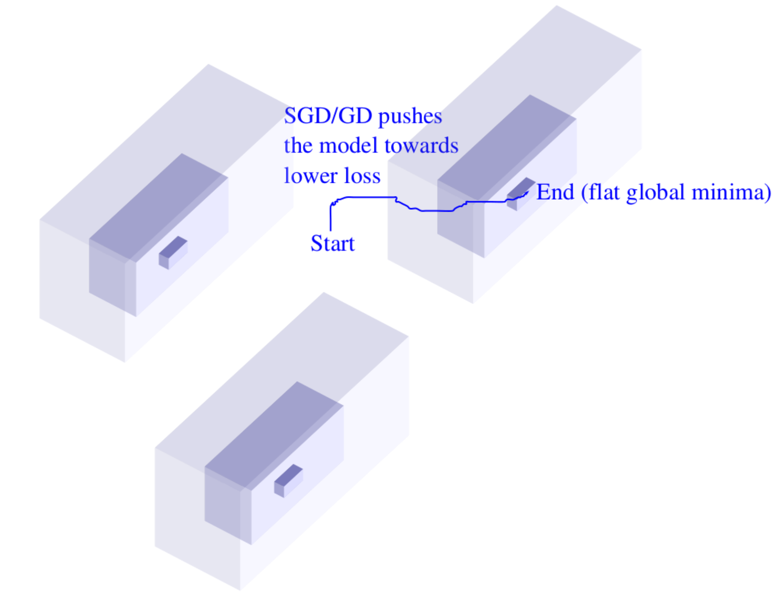
The (connected) set of global minima in one
basin of attraction is a nonlinear manifold of
very high dimension in the zero error case
Global minima
(Degenerate)
Different weight vectors have
different Hessian properties
Liao and Poggio, Theory of deep learning II, June 2017
Notes:
Nonlinear manifold is mentioned only as a possibility. In general, loss exactly becoming zero is not what we want to study, but the weight space where loss takes decently small error values.
In general, the structure (Loss as a function of weights) is a lot more complex in DNNs (compared to linear solutions), and that too, in over-parametrized DNNs. Bad local minima (minima with high loss values), Good local minima (minima with small loss values); also, just because the loss value if very small (say, even a global min) it doesn’t mean it is a good place to be for great generalization; what seems more important is to be at places where loss is decently small and also has a flat behavior.

Slide 22
Empirical Analysis of SGD
Keskar et al did many experiments to understand the effect of batch size on SGD

Slide 23
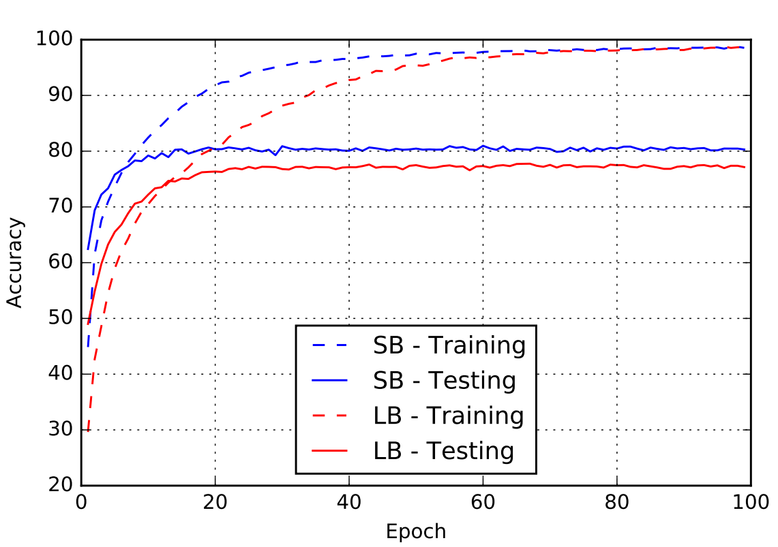
Large batch yields inferior generalization..
Keskar et al: This is due to flatness properties of solutions
This experiment was done on a modified AlexNet (CNN) on CIFAR-10 dataset
Notes:
We already made this observation on large versus small batch at the beginning of the talk.

Slide 24
Flatness was first advocated in Hochreiter and Schmidhuber, 1997.
Keskar et al’s definition of Sharpness of a solution w (Flatness is the inverse of Sharpness)

Slide 25
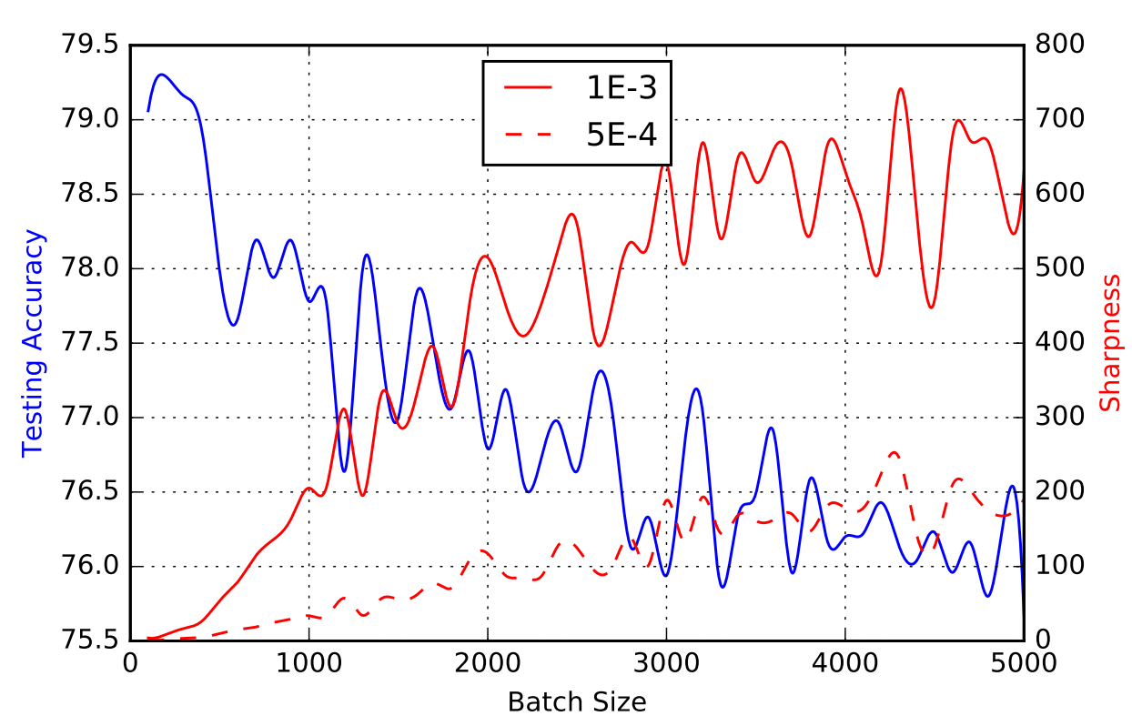
Generalization (negatively) correlates well with sharpness, thus explaining the superiority of small batch over large batch
This experiment was done on a modified
AlexNet (CNN) on CIFAR-10 dataset
Continuous red line: ; Broken red line:

Slide 26
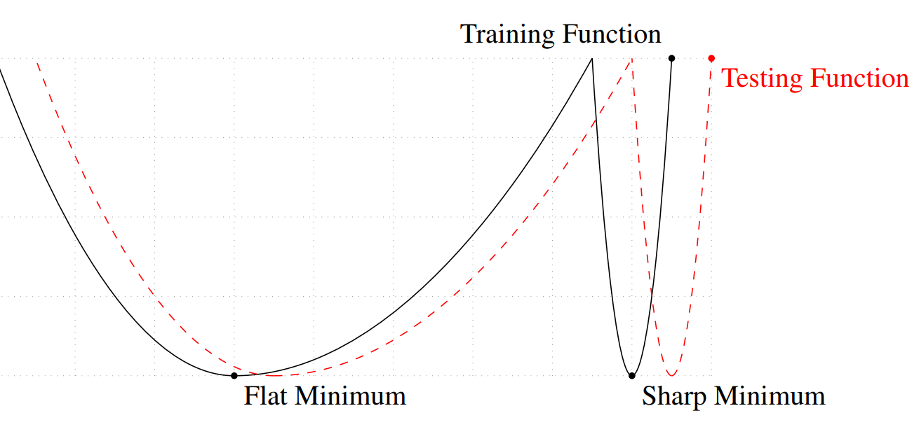
Why flatness means better generalization?
Good
Bad
Flatness implies that the test loss will be close to the training loss
Notes:
Essentially, we are talking about robustness of the error in the weight space.

Slide 27
How does SGD find Flat minima? [Ref]

Slide 28
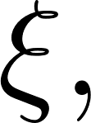
Langevin approximation
SGD: where
Now can be approximated well by a Gaussian which has zero mean and a variance that is proportional to
This yields the (discretized) Langevin system,
The probability distribution associated with this system is the Boltzmann distribution
Large B: Deterministic (not good). Small B: Too noisy (also not good)
(SGDL)
Notes:
Note the interesting formula for the variance gamma of the noise xi: eta*[(n/B)-1]. Thus noise level can be decreased by reducing the step size as well as by increasing the mini-batch size B. This idea has been expanded in a recent paper: https://arxiv.org/pdf/1711.00489.pdf. Note that,when B is chosen large, then much fewer gradient updates are needed.
The variance gamma can be thought of as an important hyperparameter on which generalization depends on.

Slide 29
An error function with one sharp and one flat global minima
A Simple Example
1
2
Frequency histograms of GDL. Note the low values for the sharp minimum
3
It would be interesting to do a better example where flatness changes within one set of degenerate global minima.
Notes:
The importance of flatness rather than deep loss value has to be stressed.
The key point to note is that, though Boltzmann distribution says even sharp global minima points have high probability of occurring, when the actual sampling algorithm is implemented it tends to put high probabilities in flat places. So, both, smallness of error values as well as smallness of error in the surrounding region together help a point to have high probability of being visited. It is this factor that makes SGD go to flat places. All these need to be properly formalized.

Slide 30
The (connected) set of global minima in one
basin of attraction is a nonlinear manifold of
very high dimension in the zero error case
Global minima
(Degenerate)
In the end phase, sgd moves
within a region of low loss values
and settles in regions with good
flatness properties
Different weight vectors have
different flatness properties
Liao and Poggio, Theory of deep learning II, June 2017

Slide 31
SGD End phase – some conjectures
Gradient size remaining small means
We remain within the basin of one global minimum
Loss values remain small throughout the diffusion phase
The fact that we consistently get good generalization irrespective of random initialization means that
All global minima have flat regions. [Showing/Arguing the existence of such flat regions within each degenerate global minimum is an interesting direction for research.]
Training algorithms just have to make sure that they move the weight exploration to the flat parts. Clearly, SGD does this so well.

Slide 32
Nailing Flatness Cleanly
For DNNs, Flatness plays a role similar to Margin for kernel methods
Capacity is controlled by the the amount of flatness of the weight vector found
A precise definition of flatness using which necessary and sufficient conditions can be given for generalization, is an active topic of research.
Such a definition, if it also lends itself to easy computation, can also act as a regularizer for DNN training. Two examples:
Elastic-SGD: Maximize
Path-SGD: With RelU activation, scaling of weights in one layer can be compensated for exactly in a subsequent layer. Path-SGD works with “steepest descent” direction under such scaling invariance.
Continuing our discussion of flatness, let us also connect it to some recent Sensitivity and Information theoretic analysis..

Slide 33
Input-Output Sensitivity [Ref]

Slide 34
Sensitivity of Input-Output Map
Sensitivity can be measured as the Frobenius norm of the Input-Output Jacobian of a DNN
Sensitivity has great correlation with Generalization in over-parametrized DNNs
This is not surprising.
When used as a regularizer, its equivalence with data augmentation using input noise injection is well known.
It would be interesting to explore relation between Sensitivity and Flatness.
Would Sensitivity used as a regularizer in the end phase allow large batch gradient methods to generalize equally well as mini-batch SGD?
Notes:
The last bullet – Sensitivity involves derivatives of the error wrt inputs. Flatness involves the derivative of the error wrt weights. Given that weights and inputs (+activation signals) are intertwined, there could be a nice correlation between the two measures.

Slide 35
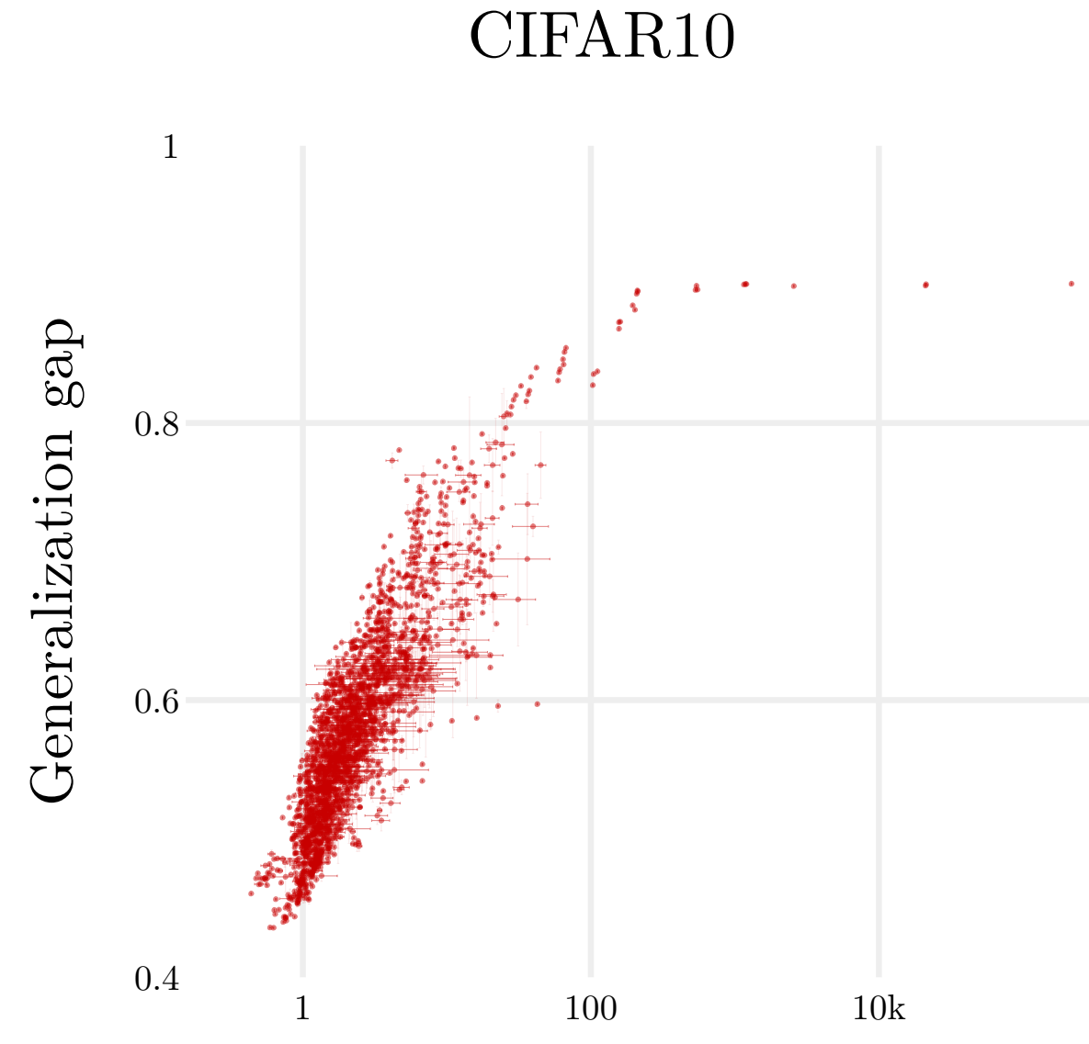
Sensitivity correlates well with Generalization

Slide 36
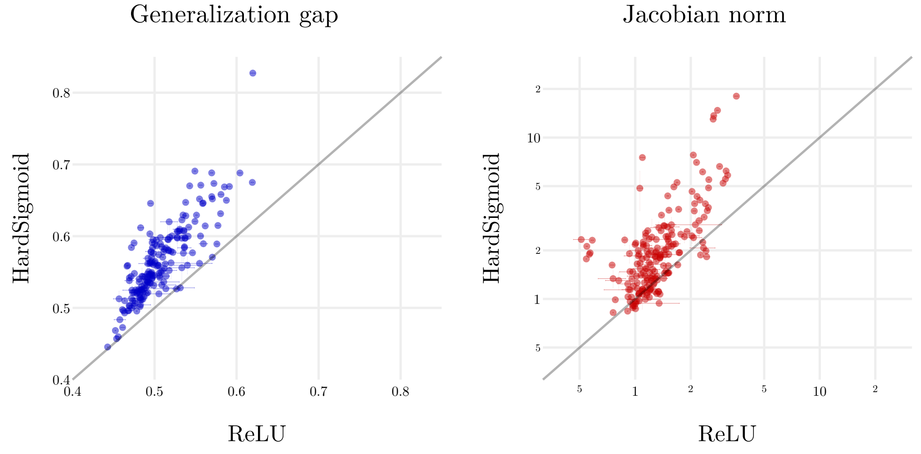
ReLU generalizes getter than HardSigmoid
Note again, the correlation between Sensitivity and Generalization

Slide 37
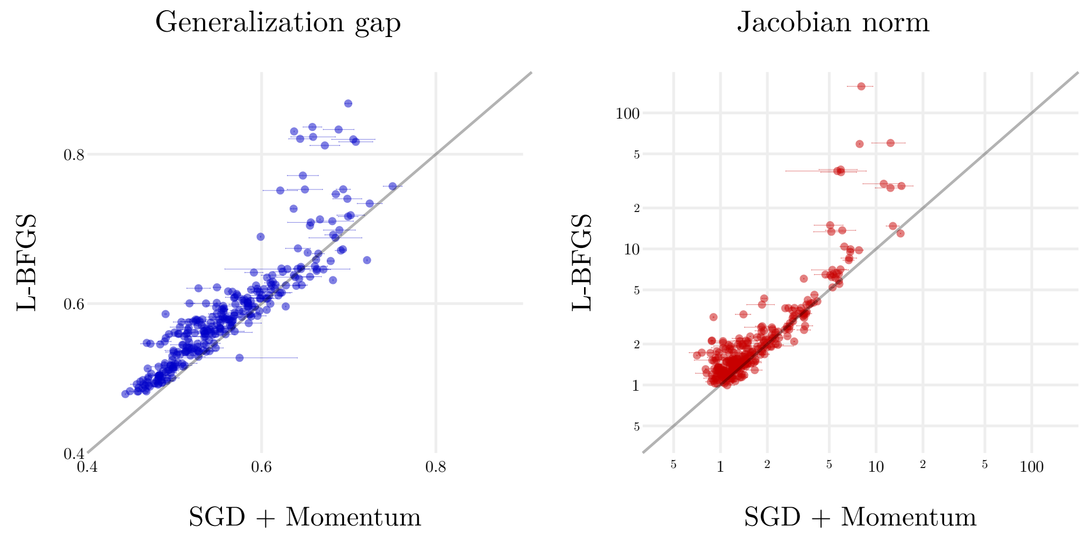
SGD generalizes better than a Full Batch method (BFGS)
Note again, the correlation between Sensitivity and Generalization

Slide 38
Information Bottleneck View [Ref]
This work does not give any working recipes for the practitioner.
But it tries to give insights into the working of DNNs and SGD.
Paper rejected by both ICML and NIPS this year. ☹
But it obtained a lot of press coverage.
A recent paper has disputed some key results from this work.

Slide 39
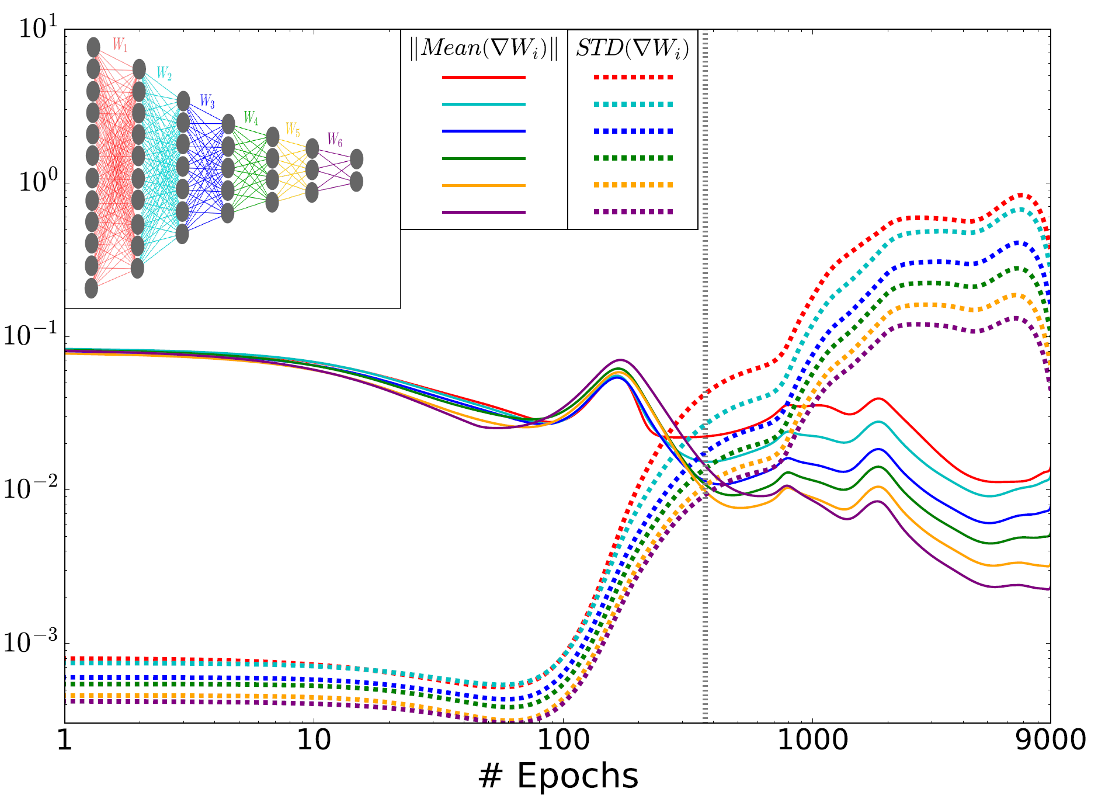
An interesting observation..
Consider the gradient of the loss with respect to the weights
Phase 1 (Drift) – Mean gradient size is much larger than the standard deviation
Phase 2 (Diffusion) – Mean gradient is smaller and noise takes over (the magic of Langevin comes here) – Langevin/Boltzmann effect kicks in here

Slide 40
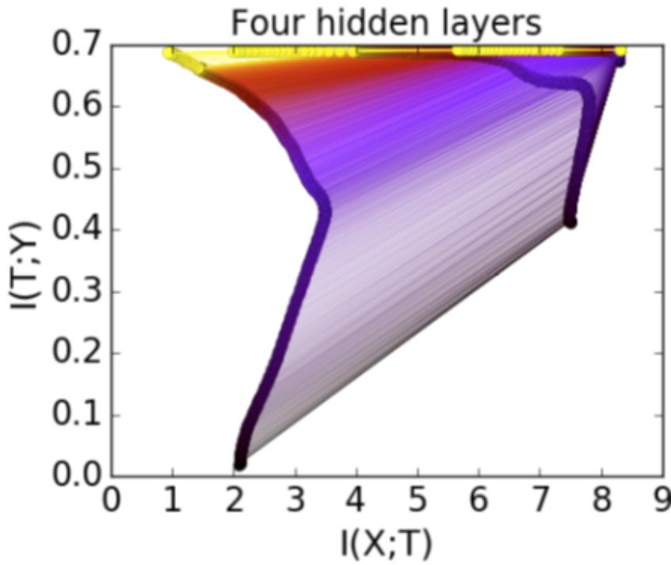
The controversy..
Shwartz-Ziv and Tishby claimed that SGD training compresses (reduces I(X;T)) in the diffusion phase
This has been countered by a recent submission to ICLR that points out that the compression is an artifact of binning associated with tanh neuron outputs.

Slide 41
DNNs being tolerant of Over-parametrization –
Does it mean
is a Reality? No, not necessarily!
Notes:
Image borrowed from a tweet from Indico – the reference of “DNNs and Small datasets” was actually with transfer learning in mind.

Slide 42
Training error
Testing error
Training set is large means the two
error curves are close to each other.
Combined with flatness this yields
good generalization
Training set is small means the two
error curves are away from each other.
Even with good flatness this may mean
bad generalization
Notes:
If you have seen contours of the train and test loss functions in weight space, you will get a good feel of the above.
We have conceptually shown the testing error as a shifted version of the training error. In reality there are quite possibly other types of deformations. Also, in high dimensional weight spaces, in which directions do the shifts/deformations occur, and, in those directions is the error function flat, etc. are important. There are wealthy directions of research here.
Having laid such a warning on the use of DNNs on small data, it may be worthwhile to compare the performance of small versus large nets on small data.

Slide 43
Final Comments

Slide 44
Summary
Over-parametrized DNNs trained using (not-so-large) mini-batch generalize well
Analysis of similar observation on kernel methods does not explain what happens in DNNs
Where an optimization algorithm lands in a complex region of low error values decides generalization
Good generalizing regions are associated with flatness
The diffusion phase of SGD is crucial for going to flatness regions

Slide 45
Final comments
Noise in training is necessary to generalize well
SGD does well, fine! But
Variants such as plain mini-batch SGD, Adam etc. behave differently
Also, SGD is not designed with generalization in mind
So, it is an uneasy feeling to remain satisfied just knowing SGD does well
Better understanding of the following are needed
Structure of degenerate global minima,
Properties of the nearby low error region,
What precisely causes good generalization to happen, and
Quantify Flatness so as to correlate it well with Generalization
Come up with regularizers such that minimization of the regularized loss pushes weights to good generalizing solutions
If there are many such good solutions, can Bayesian averaging be explored using a Flatness-based posterior?
Notes:
It would be even a good idea to explore a simple approach to averaging.
To look at:
Smith & Le - https://arxiv.org/pdf/1710.06451.pdf and make some comments on Evidence (within the vicinity of one global minimum)?
Also, I haven’t covered theory works at all in my talk.
Unlike Mackay who talked about evidence in the entire weight space including all global minima, which is a messy thing to handle, simple studying Evidence restricted to one “basin of attraction” is very relevant for describing flatness.

Slide 46
Questions?

